Slide 1
Dallas Crime Data Analysis

Slide 2
Introduction
Crime Analysis is an important law enforcement function which involves systemic analysis to identify and analyze patterns and trends in crime and disorder
Although the crime statistics in Dallas report an overall downward trend based on data from 18 years, crimes do happen every day
The Dallas Police Department – Records Management System collects the crime reports in a timely and accurate manner
The data is taken from www.dallasopendata.com
Predictive techniques can be used to identify criminal hotspots dynamically in order to reduce crime incidents
We will perform Data cleaning and visualization to understand the data we are dealing with and build a model to predict future crime rates

Slide 3
Problem Definition
The objective of this project is to analyze the trend in crimes from the year June 2014 to current date.
Find the time of day and day of week when most crimes tend to occur
Analyze the trend of different categories of crime
Find the most used weapons in crime scenes
Identify areas in the city where there are less crimes
Relationship between crime types and victim’s characteristics
Year on year increase in overall crimes and also specific types of crimes
Predict the crime rate for the next year

Slide 4
Data Pre-Processing
The data reflects crime incidents from June 2014 to current date
There are about 100 columns and over 585K records
Only the columns required for analysis are taken which includes Type of Incident, Incident Number, Division, Date of Occurrence, Offense Type, Weapon used, Victim Condition, etc.
Duplicate rows are removed based on the Incident Number
Handling of missing values, outliers and NAs, correcting field values are done for columns including Date of Occurrence, Year of Incident, Division, Victim Age.
New variables – Season, Hour of Day are included based on month and time respectively
Similar Offense Types and Weapon Types are grouped together

Slide 5
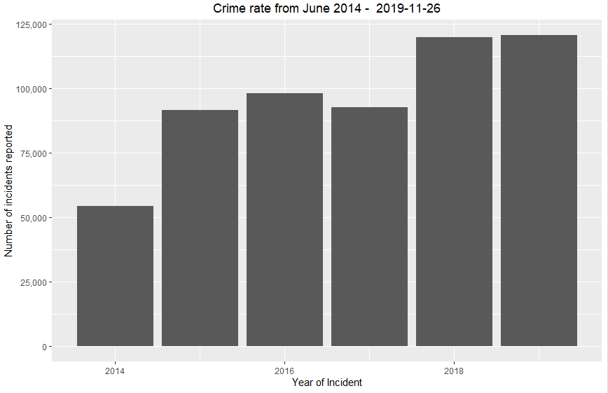
Data Visualization
Data Visualization is a powerful way to understand the data and its underlying patterns
Package ggplot2 is used to visualize the patterns
Powerful aggregation functions like summarise and tally from dplyr package are used
Below are the crime rates from June 2014 – August 2019 in Dallas

Slide 6
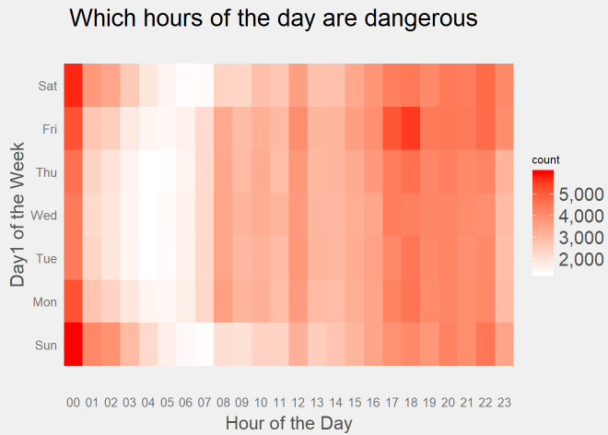
Data Visualization
Time of day and Day of week when most crimes tend to occur

Slide 7
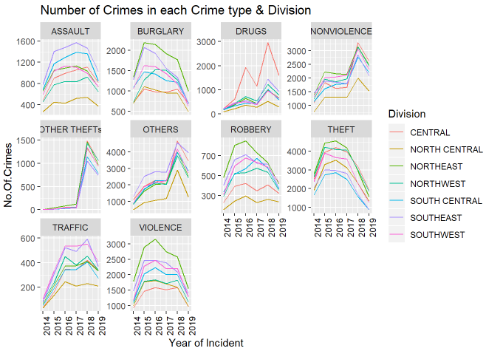
Data Visualization
Analysis of different categories of crime

Slide 8
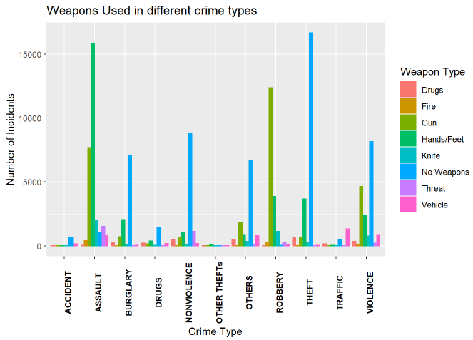
Data Visualization
Most used weapons in crime scenes

Slide 9
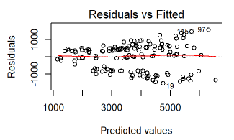
Modeling
Looking at the visualizations, there is a significant increase in crime incidents with respect to time of the day
The predictor variables to build a model are - Year of Incident and Hour of the Day
Analysis of Variance (ANOVA) proves that the two predictor variables are statistically significant
With Linear Regression we predicted that about 115,884 crime incidents will happen in the year 2020
Predicted values are too high compared with the actual values so there is a room for improvement here

Slide 10
Conclusion
With POISSON and QUASSIPOISSON model, there was a problem of over-dispersion
After Log Transformation of Linear model, the model has improved
There are several other predicting techniques that can be built to fit a better model and predict crime rates for future years
Such techniques can be used to further investigate and identify crime prone localities, help deploy security systems and make use of them effectively
This helps reduce crime rates in upcoming years

